Slide 1
MENT Guiding You
HOME
ABOUT US
CONTACT
SIGN IN
SIGN IN
Username
Password
Submit
Forgot Password
Create Account

Slide 2
MENT Guiding You
HOME
ABOUT US
CONTACT
SIGN IN
Create Account
Mentor
Mentee
Email
Password
Confirm Password
Phone
About You
Create

Slide 3

MENT Guiding You
HOME
ABOUT US
CONTACT
My Account
Log Out
VIEW MENTORS

Slide 4



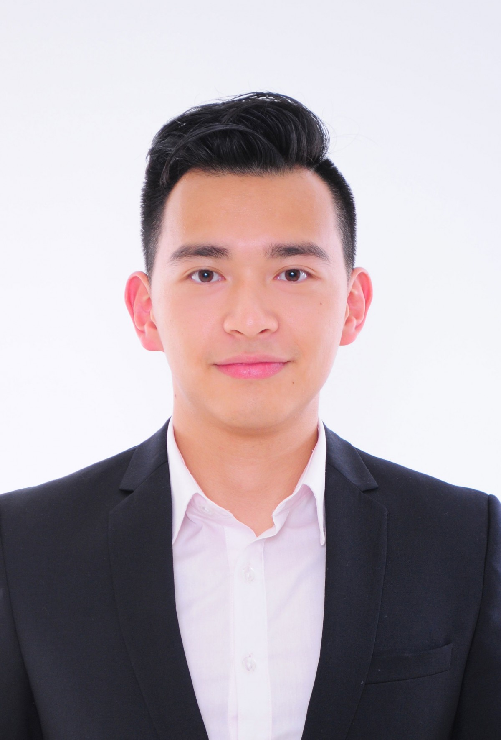
MENT Guiding You
HOME
ABOUT US
CONTACT
My Account
Logout
Mentors
Sort
Filter
hdmentor1
***
****
Mentor2
>
>
*
Mentor3
**
Mentor
>
>

Slide 5
MENT Guiding You
HOME
ABOUT US
CONTACT
My Account
Logout
Mentors
Sort
Filter
No Image
Blur
>
No Image
Blur
>
No Image
Blur
No Image
Blur
>
>

Slide 6
MENT Guiding You
HOME
ABOUT US
CONTACT
My Account
Logout
Mentors
Sort
Filter
Limited Access
No Image
Blur
>
No Image
Blur
>
Sign In to continue
No Image
Blur
No Image
Blur
>
>

Slide 7
MENT Guiding You
HOME
ABOUT US
CONTACT
My Account
Logout
Mentors
Sort
Filter
hdmentor1
Sort By Rating
***
****
Mentor2
>
>
*
Mentor3
**
Mentor
>
>

Slide 8
MENT Guiding You
HOME
ABOUT US
CONTACT
My Account
Logout
Mentors
Sort
Filter
mentor2
****
***
Mentor1
>
>
**
Mentor
*
Mentor 3
>
>

Slide 9
MENT Guiding You
HOME
ABOUT US
CONTACT
My Account
Logout
Mentors
Sort
Filter
hdmentor1
3 Starred
***
****
Mentor2
>
>
2 starred
*
Mentor3
**
Mentor
>
>

Slide 10

MENT Guiding You
HOME
ABOUT US
CONTACT
My Account
Logout
Mentors
Sort
Filter
hdmentor1
mentor4
***
>
***
>

Slide 11
MENT Guiding You
HOME
ABOUT US
CONTACT
My Account
Log Out
Mentor 1 ***
VIEW AVAILABLITY

Slide 12
MENT Guiding You
HOME
ABOUT US
CONTACT
My Account
Log Out
Mentor1’s availability
SUN MON TUE WED THU FRI SAT
8:00
9:00
10:00
11:00
12:00
13:00
14:00
15:00
16:00
17:00
18:00
Available
Available
Available
Available

Slide 13
MENT Guiding You
HOME
ABOUT US
CONTACT
My Account
Log Out
Mentor1’s availability
SUN MON TUE WED THU FRI SAT
8:00
9:00
10:00
11:00
12:00
13:00
14:00
15:00
16:00
17:00
18:00
Confirm Meeting
From XX:XX
Available
To XX:XX
Looking For:
Available
Cancel
Confirm
Available
Available

Slide 14
MENT Guiding You
HOME
ABOUT US
CONTACT
My Account
Log Out
MEETING SUCCESSFULLY SCHEDULED
Meeting link is sent to your registered Email
NOTE: Please login after the meeting and rate the mentor to improve the experience for others

Slide 15
MENT Guiding You
HOME
ABOUT US
CONTACT
My Account
Log Out
Rate Your Mentor
****
Feedback
SUBMIT

